Slide 1

Projects Using React.js & Flux
Project 8: Youtube Gallery

Slide 2
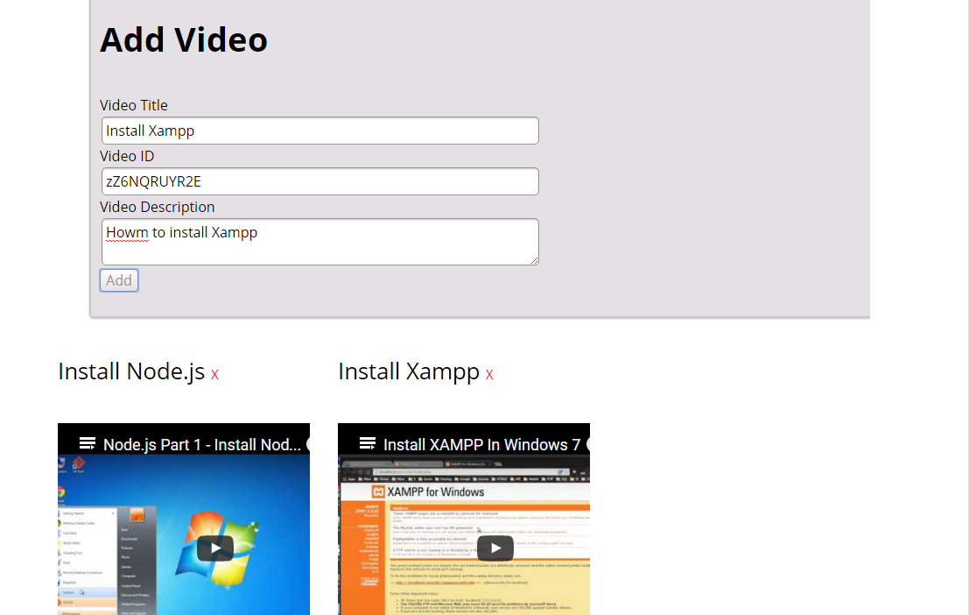
Project Description
Simple gallery to add Youtube videos with custom titles and descriptions using the ID in the Youtube URL

Slide 3
Project Lectures
Section Intro
FluxBoiler Setup & Add Video Form
Persist Data to Firebase
Displaying Videos
Deleting Videos

Slide 4
What You Will Learn
Create a Flux boilerplate
How to persist video data to Firebase
How to display and map through video data

